Slide 1
創意
與
實踐
報告人
成功大學 圖書館
王涵青
Notes:
如何從瞬息萬變的浪潮中以創意找出生存之道

Slide 2
“Librarians are good at creating order from chaos but the challenge is to simultaneously show features of creativity whilst also maintaining this order.”
—Schacter, 2005—
Schacter, D. (2005), “Creative chaos: innovation in special libraries”, Information Outlook, Vol. 9 No. 12, pp. 10‐11.

Slide 3
唯一不變
就是
世界永遠在變
「創意與實踐」
因應瞬息萬變環境最佳解
Notes:
最佳解的三帖良藥：空間改造、課程(活動)、合作
圓圈外的繽紛代表瞬息萬變的環境

Slide 4
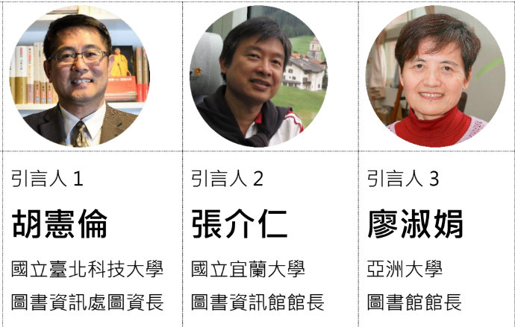
以創意實踐價值
張介仁館長

Slide 5
圖書館的永續創新
永續創新(Sustainable Innovation)
或稱永續驅動的創新(Sustainability-driven innovation)
不是為創新而創新
而是為了有益永續發展而創新。
全新的思維及典範的轉移(Paradigm Shift*)
對於掌控人類生活之科學理論之基本假設的改變
Breakthrough Mindset
Exponential Innovation
Waves of Innovation Diagram (Source: Hargroves et al (2005, p17)

Slide 6
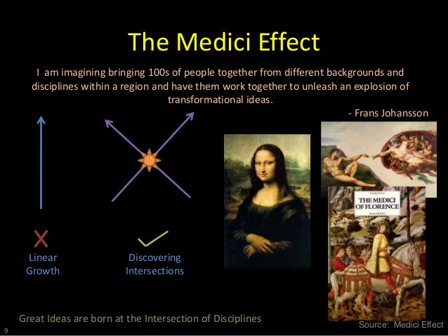

永續創新的主要來源
跨領域整合
梅迪奇效應 (Medici Effect)
當跨入不同領域、學科、文化的交會點時，將會因結合現有的觀念而創造出大量的、突破性的新想法
天下雜誌
Notes:
善於創新發明的人都進入了「異場域碰撞的交會點」
在那裡找到新構想，改變了世界，這個交會點就是不同領域和文化的構想交流與激盪，最後引發傑出新發現不斷湧現的地方。

Slide 7
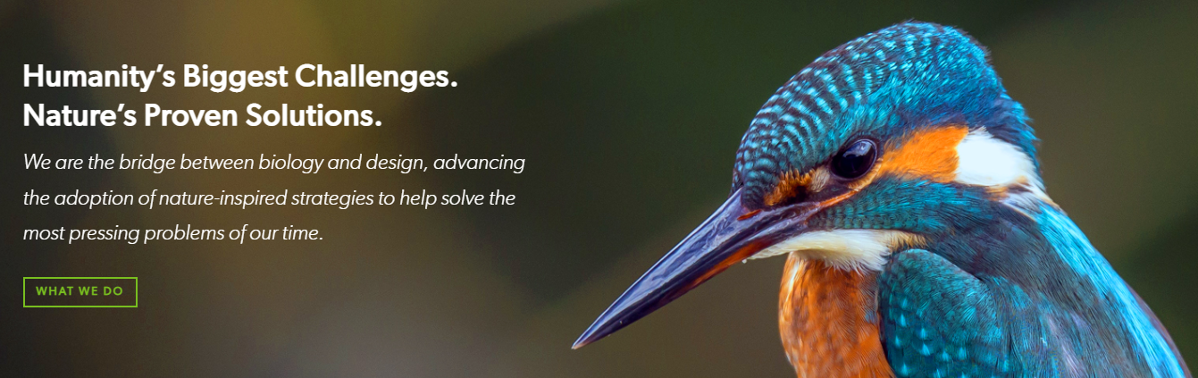
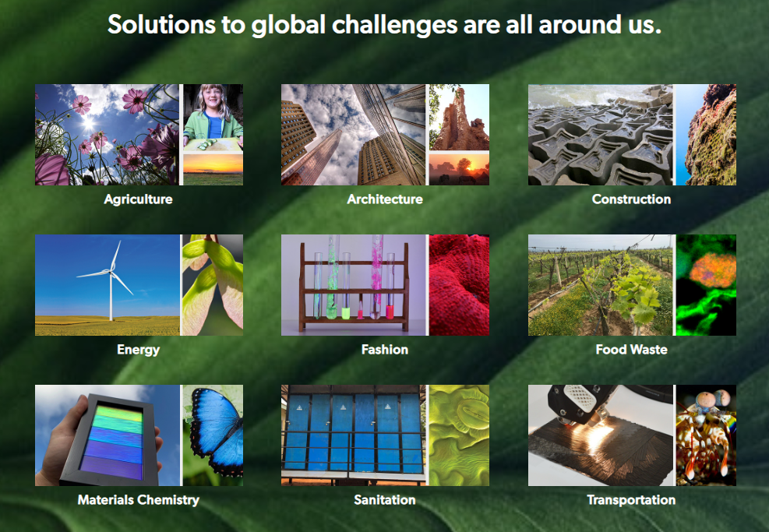
生物模擬(Biomimicy)-仿生學
https://biomimicry.org/
生物模擬
生態智慧(Eco-intelligence)
從生態現象啟發得到社會智慧的學問

Slide 8
圖書館內部
Evener, J. (2015). Innovation in the Library: How to Engage Employees, Cultivate Creativity, and Create Buy-In for New Ideas. College & Undergraduate Libraries, 22(3-4), 296-311. https://doi.org/10.1080/10691316.2015.1060142
定型與成長心態
定型
Fixed mindset
成長
Growth mindset
拒絕學習機會
擁抱正向的失敗
Embrace positive failure
不畏失敗
安於現狀
勇於突破
賦予工作彈性
Autonomy of Task
害怕挑戰
視挑戰為精進機會
Notes:
擁有固定心態的人 "拒絕學習的機會"，而是在生活和工作中走容易、安全的路線。然而，當他們了解大腦如何運作的基本科學知識，並且知道增強智力和創造力是可能的時，他們就轉向成長心態，更有可能接受挑戰。換句話說，即使是認為自己沒有創造力的圖書館員，如果他們相信自己可以做到並為此而努力，也能變得有創造力。
People with fixed mind-sets “reject opportunities to learn” and instead stay on the easy, safe paths in life and work. However, when they learn the basic science behind how the brain works and that increasing capabilities like intelligence and creativity is possible, they switch to the growth mind-set and are more likely to take on challenges. In other words, even library employees who believe they are not creative can become creative if they believe that they can do so and work toward it.

Slide 9
唯一的不變就是世界永遠在變
「創意與實踐」是因應瞬息萬變環境的最佳解
空間改造
創意
跨單位合作
課程/
推廣
Notes:
最佳解的三帖良藥：空間改造、課程(活動)、合作
圓圈外的繽紛代表瞬息萬變的環境

Slide 10
Head, A. (2016). Planning and designing academic library learning spaces: Expert perspectives of architects, librarians, and library consultants. Librarians, and Library Consultants (December 6, 2016).
w
l
o
改
F
空
將人潮、合作、創意等引流至館內
Open-ended
Learning hub: 結合資訊、師生參與、科技
Co-curricular
教育趨勢：偕同、互動式、線上或混合式教學
Flexible
User-defined: 依照當下學習需求，自行重新配置空間
「彈性」是因應教學環境改變的不二法門
Notes:
What is at stake for nearly every campus library today is transforming the longstanding model of housing collections into a thriving and open-ended learning hub that brings together information, engagement, and technology.
On many campuses, teaching is more collaborative, interactive, online or blended, and student learning is becoming deliberately more co-curricular
“flexible” spaces in libraries. This meant designing space that was “user-defined,” so users could reconfigure a space at a moment’s notice based on their needs. Flexibility was usually manifested in movable and customizable, and often casual furnishings and non-permanent whiteboard partitions.
Moreover, the design of library learning spaces will continue to evolve for years to come in response to seismic changes happening in pedagogy and curricular programs on campuses. This is why flexibility is an essential design element for academic library learning spaces.

Slide 11
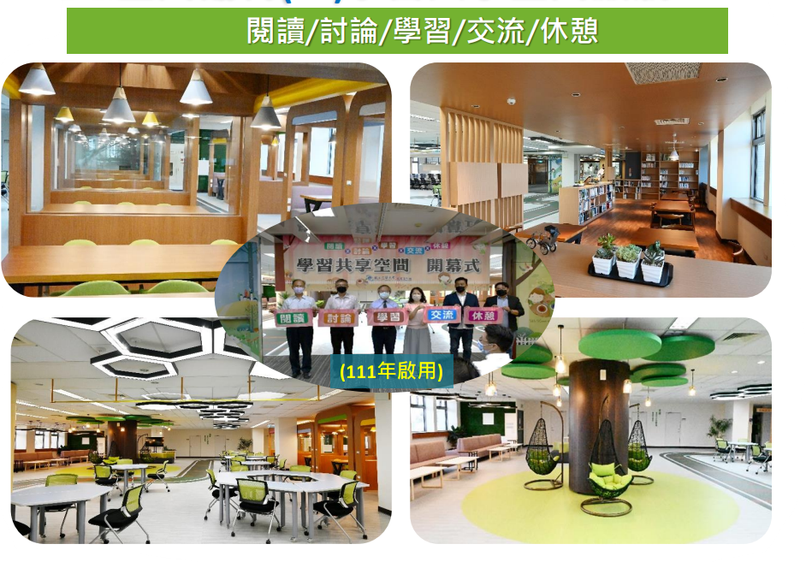
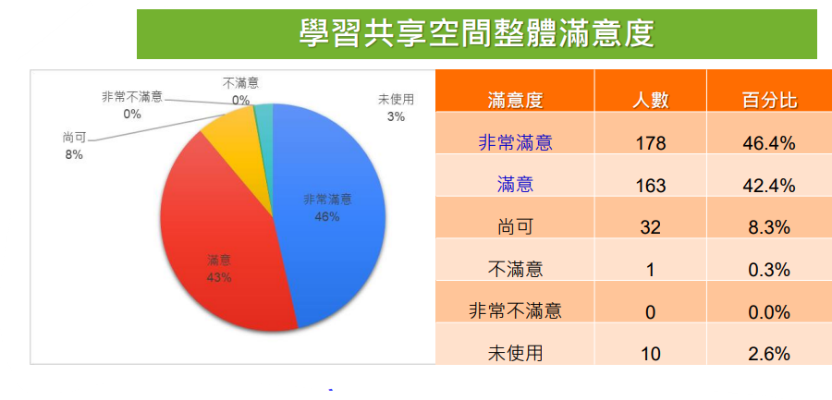
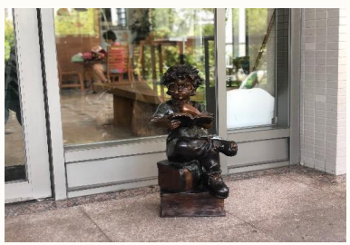
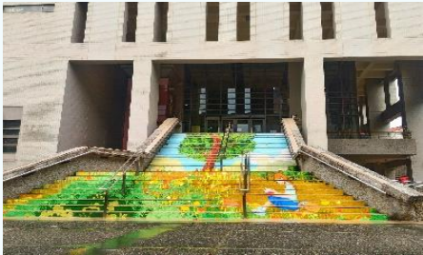
空間創新帶回學生

Slide 12
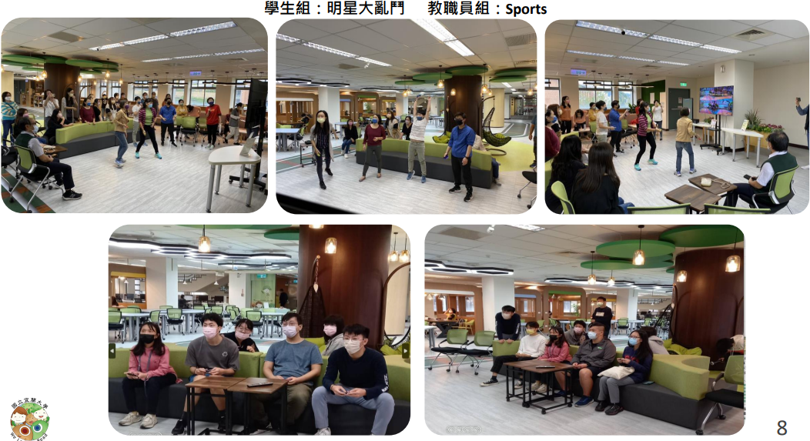
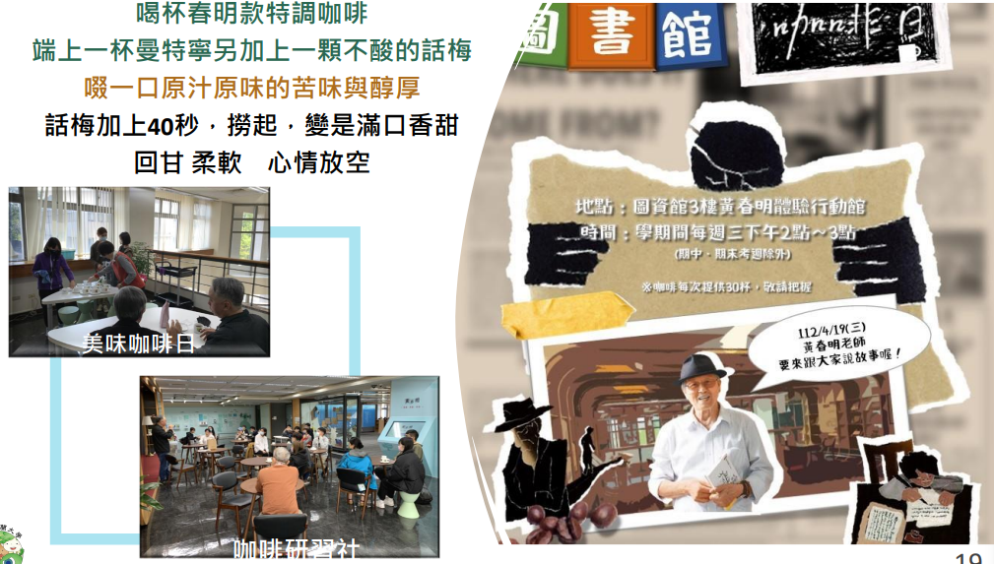
空間創新帶回學生

Slide 13
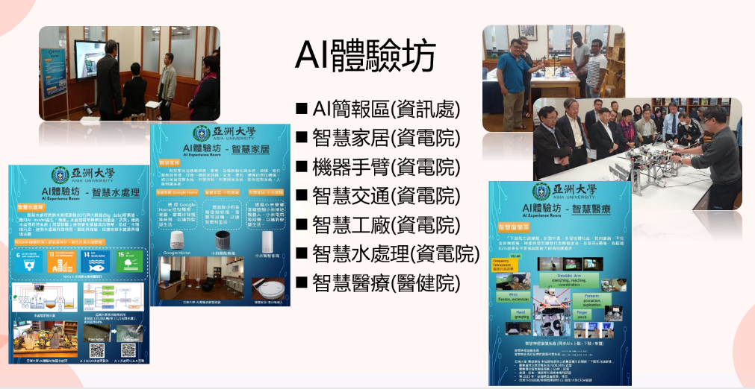
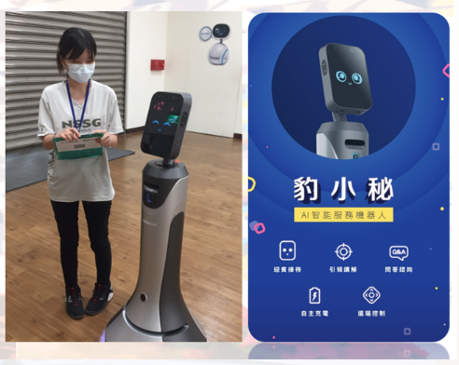
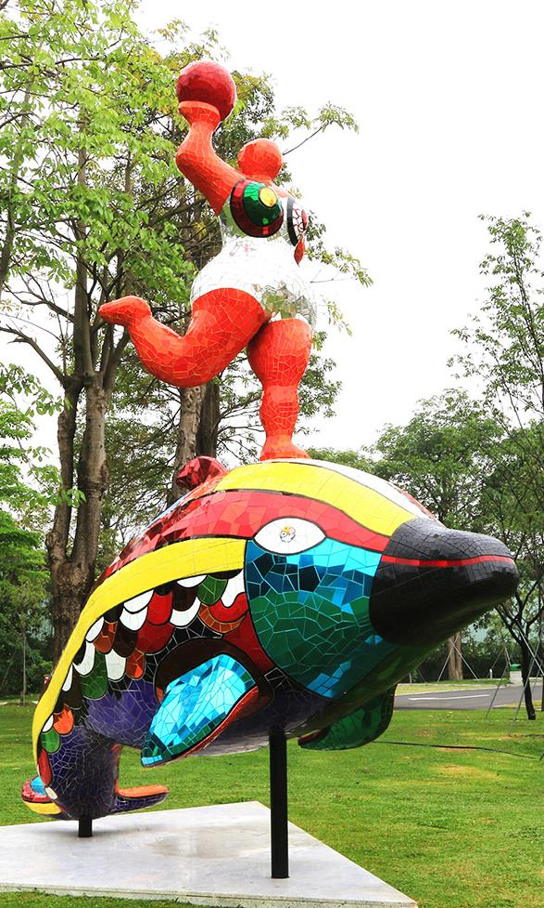
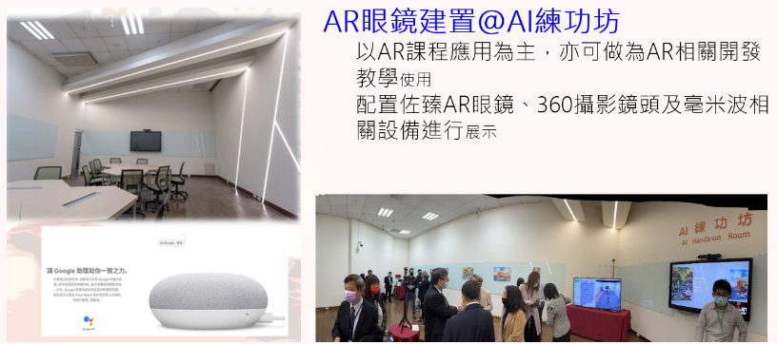
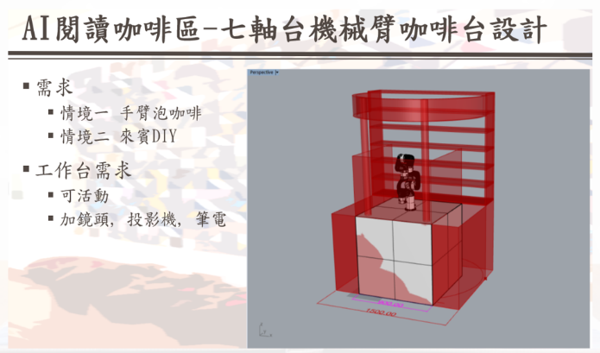
與時代潮流結合的有機體
AI教室

Slide 14
推
廣
Bailey, K., Chakraborty, M., & Shimada, J. (2022). " WOW! That Was Awesome!" Said the Students Leaving the Library Instruction Session: Integrating Tech Tools in Library Instruction. Purdue University Digital Commons.
程
Z世代如何學習?
課
從做中學
依據範例實作
A
51%
12%
從看中學
閱讀課程教材
B
38%
從聽中學
課堂聽講
C

Slide 15
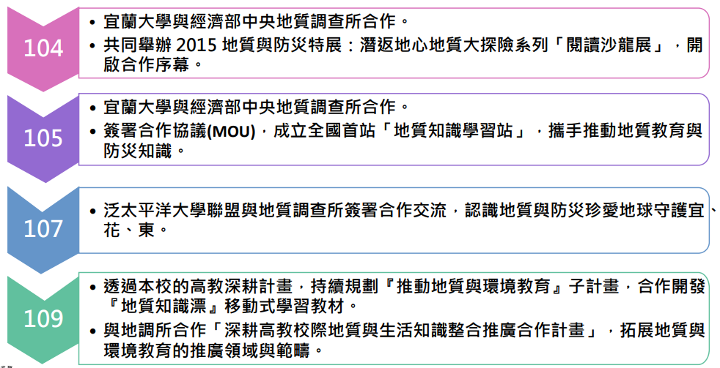
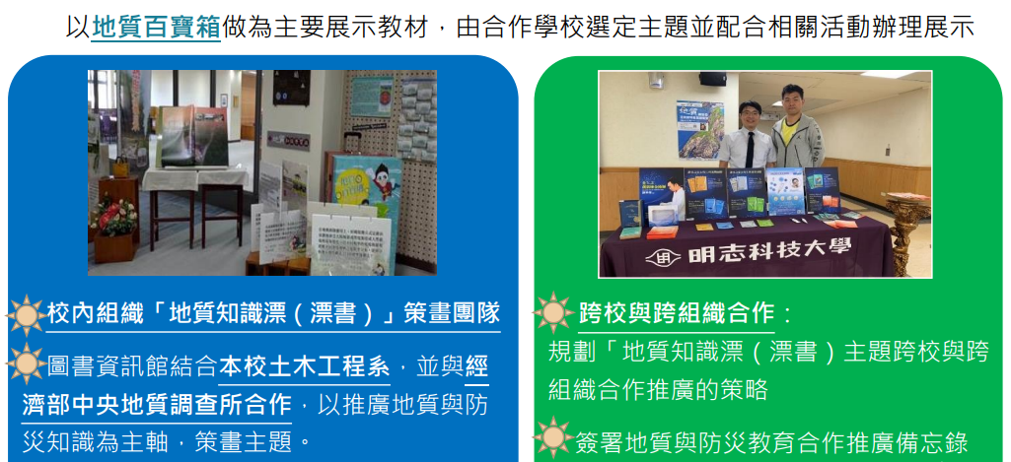
推動地質與環境教育

Slide 16
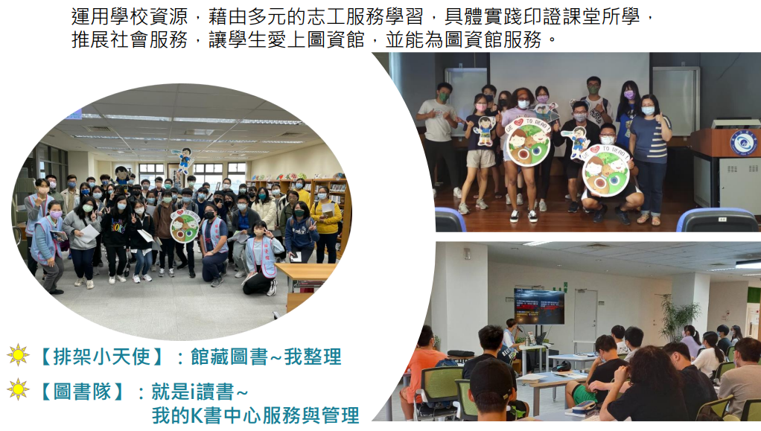
愛上圖資館─圖書小天使

Slide 17
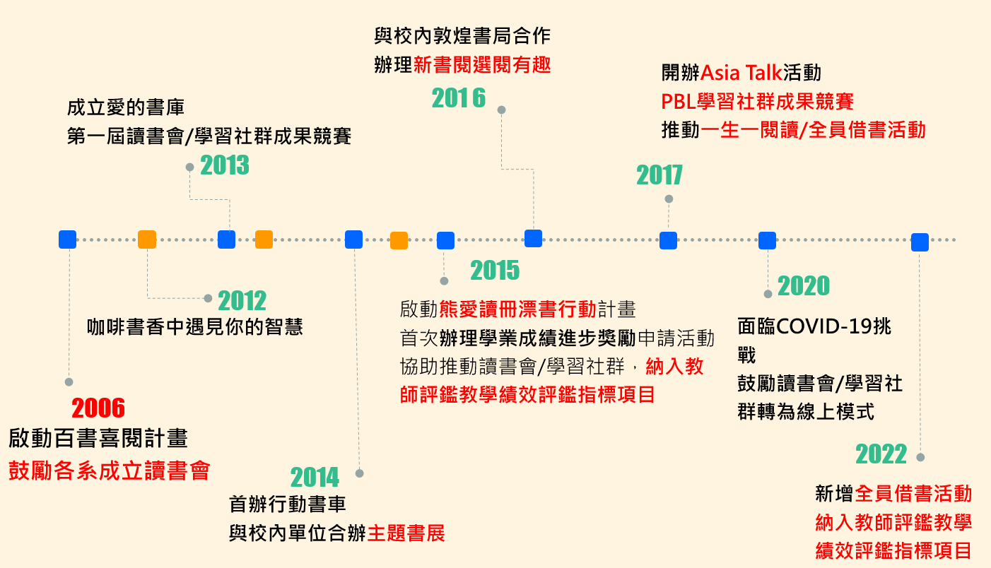
推動閱讀提升讀書風氣歷程

Slide 18

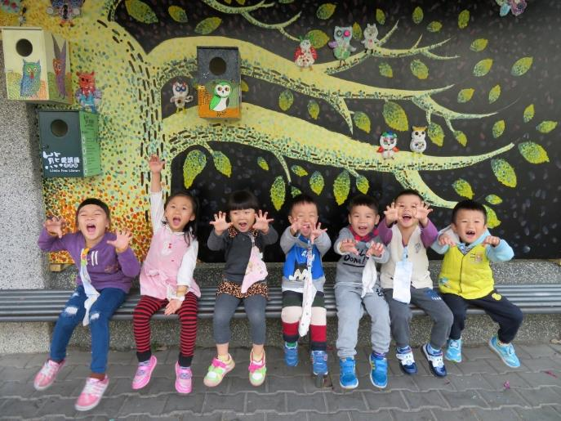
霧峰學．學霧峰
漂書行動
亞大圖書館和霧峰區熊與貓咖啡書房共同發起。
活化資源促進社區凝聚，發展文藝社群。
期望不僅在亞洲大學，也使霧峰處處漂書香。

Slide 19
Cain, K., Miller, K., & Newton, K. (2022). Creativity and cross-institutional collaboration in the DigiDex Community of Practice.
作
數位活用
合
A contextual mindset and evolving set of skills in modern digital environment
開放文化
合作強化
Within the academic library, and between and across institutions
Leverage appropriate digital tools and strategies to problem solve, communicate, and create knowledge
Notes:
The capacity to leverage appropriate digital tools and strategies to problem solve, communicate, and create new knowledge has become critical to work and educational practices.
Digital dexterity is a contextual mindset and evolving set of skills that sustain agentic , successful participation in modern digital environments.

Slide 20
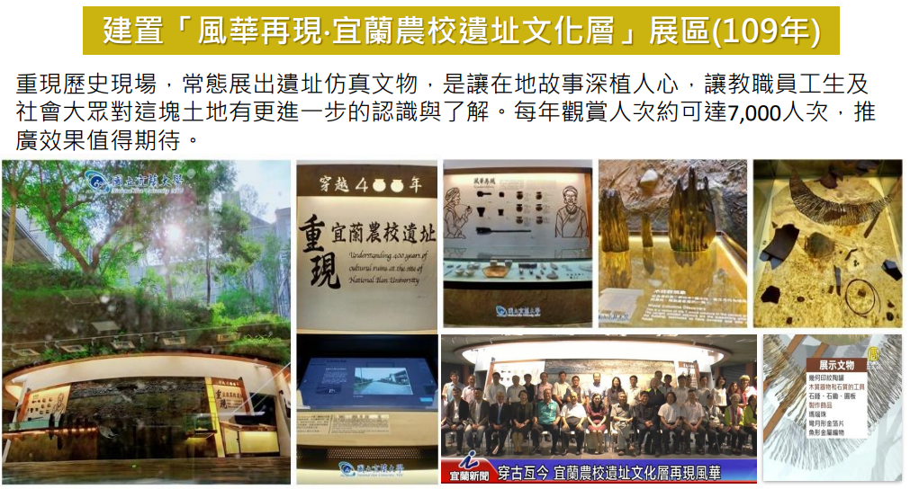
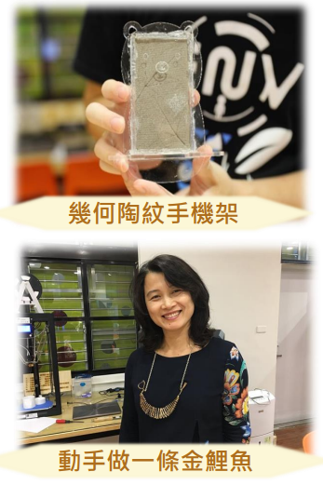
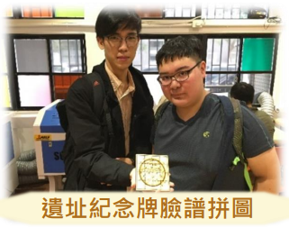
籌建校園博物館

Slide 21
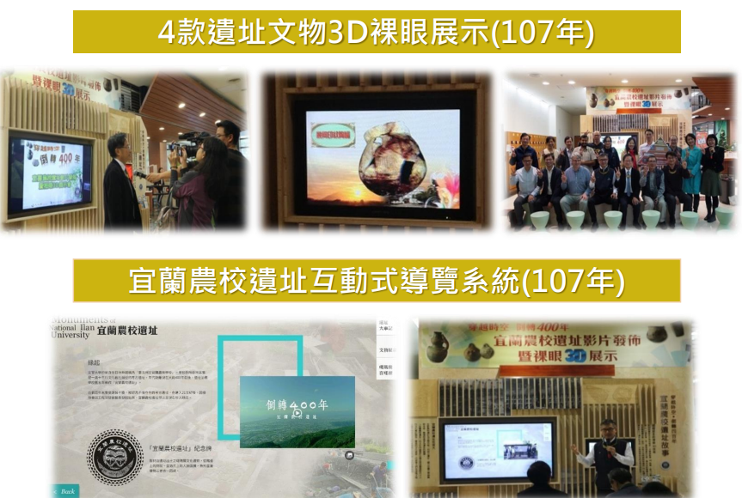
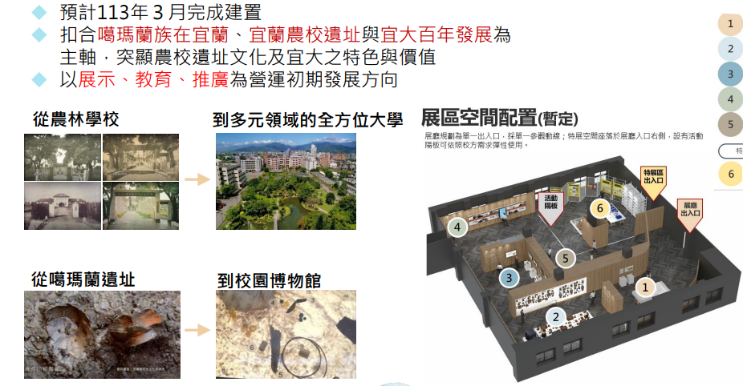
籌建校園博物館

Slide 22
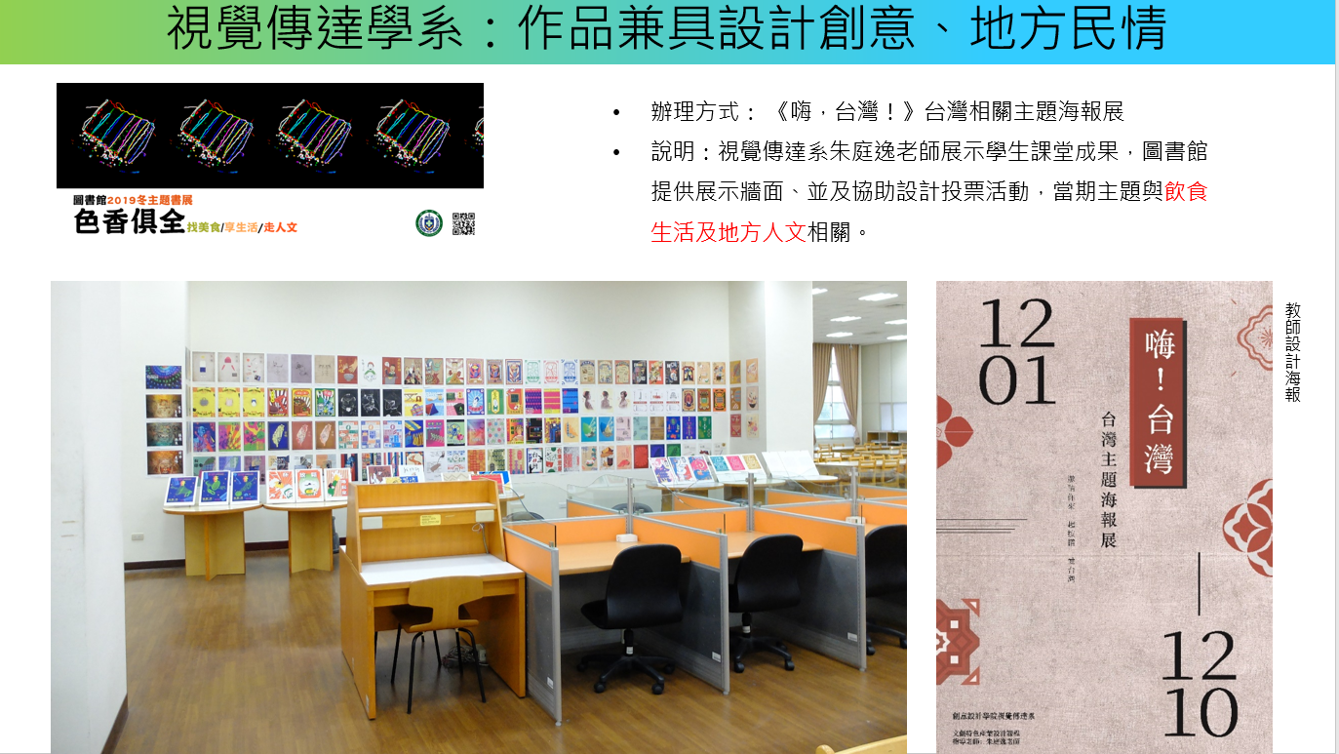
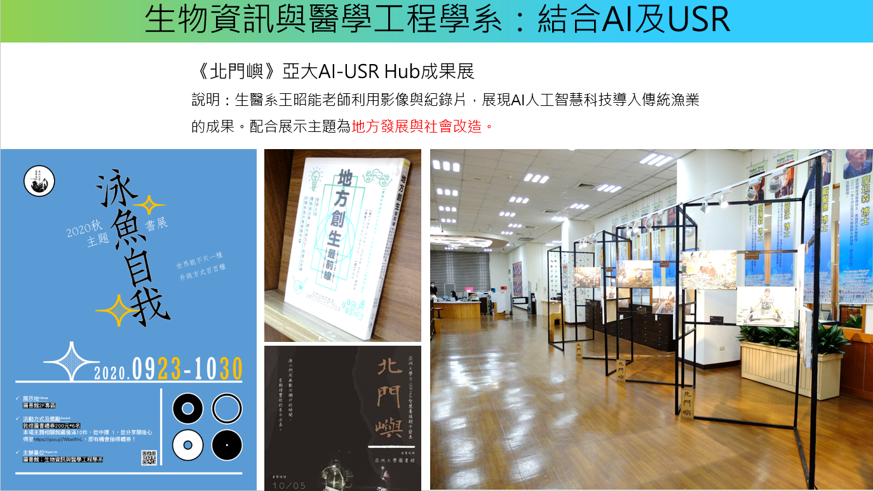

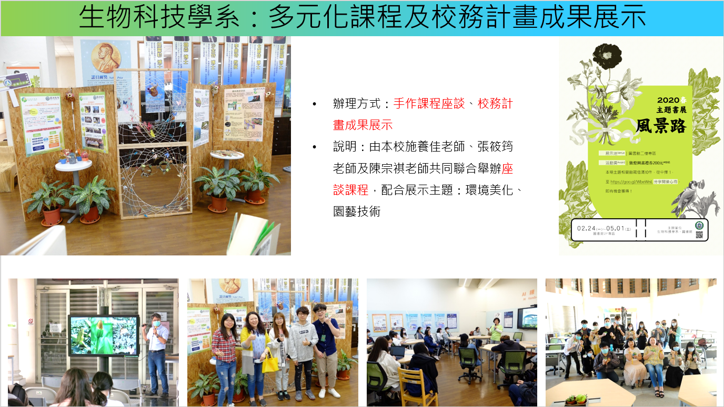
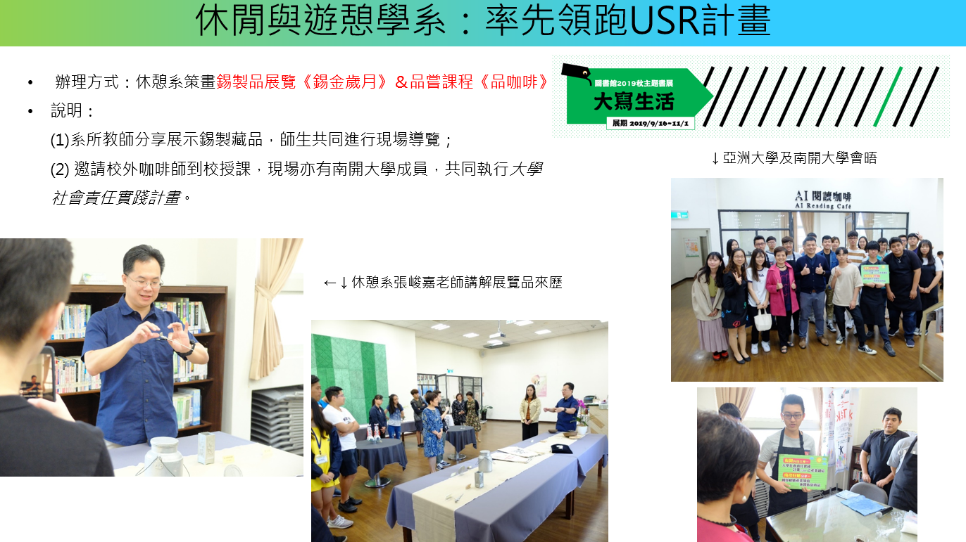
跨域合作共創雙贏

Slide 23

A Library ethos:
Collaboration, Openness, & Sharing

Slide 24
作
合
Museums
curation
Libraries
metadata
Digital humanities
Preservation & storytelling
Archives
Notes:
延續上頁數位科技的進展促進跨單位合作
Digital as well as physical infrastructure has been a catalyst for collaboration
跨單位間可互通彼此領域的metadata(後設資料)專業，例如故宮對於某古物的描述能力絕對比圖書館員專業，圖書館員則能依據編目規則描述資料的形體特性
https://ah.nccu.edu.tw/bitstream/140.119/41290/1/NccurHandle41290%E8%96%9B%E7%90%86%E6%A1%82.pdf
Museum + Library = curation 合作策展
Library + Archives = digital humanities 數位人文
Museum + Archives = 找不太到兩者之間的合作模式，只找到以下可能的內容，但有點心虛XDD
A museum archives has the capacity to tell the whole story and offer a more accurate historical understanding of the museum collection.
檔案管理專家能提供博物館員相關歷史資料以利完整描述歷史，更可進行數位保存digital preservation
https://www.aim-museums.co.uk/wp-content/uploads/2017/03/Successfully-Managing-Archives-in-Museums-Basic-Interventive-Conservation-2017.pdf

Slide 25
館員的願景和使命
願景
每個館員是學習者、每個館員是教師、每個館員是領導者
使命
創造健康環境，讓館員在友善支持的環境中，發揮長才，樂在工作，提供讀者最優質的服務。

Slide 26

「創意與實踐」
為未來送出滿滿的熱血

Slide 27
Thank you!

